Slide 1

Computational Thinking through Data Structures
Five days faculty development program
on
Organized by Presidency school of Computer Science & Engineering, Presidency University
Speaker: Dr. Sisir Kumar Jena
R&D Staff at

Slide 2
Motivation
Lets start with a simple question.
“Store 1,000,000 records”
We have 1 million records, and we need efficient:
Insert
Search
Delete
What data structure would you pick?”

Slide 3
Motivation
“If we use an array, what are the strengths?”
Case 1: Unsorted Array
“How do you search, insert, delete?”
O(n) O(1) -> at end O(n)
Case 2: Sorted Array
“Can we do better if sorted?”
Binary search → O(log n)
“What about insertion?”
Need shifting → O(n)
Array forces us to choose:
Either fast search OR fast updates — not both.

Slide 4

Motivation
Trees emerge when we want:
structure like arrays
flexibility like linked lists
and efficiency somewhere in between
What about linked list?
What improves compared to array?
Search
Insert
Delete
Linked list solves flexibility, but loses fast access.

Slide 5
Today’s Content
Trees
Binary Tree
Binary Search Tree
AVL tree

Slide 6
Tree and some terminologies
Root node: 20
Parent node: 2 is parent node of 27, 50, and 43.
Ancestor: 20 is ancestor of 28 and 21
Descendant: 28 and 21 are descendants of 20.
Siblings: 27, 50 and 43 are siblings of each other.
Children: 28 and 21 are children of 5.
Leaf node: 27, 50, 43, 28, 45 are leaf nodes.
Internal nodes: 2, 20, 5, and 21 are internal nodes.
Height: The height of this tree is 3.
Depth: The depth of 28 is 2.
Degree: The degree of 2 is 3.
20
Level 0
2
5
Level 1
27
50
43
28
21
Level 2
45
Level 3

Slide 7
Binary Tree
All node having at most two children.
Terminologies
Left subtree
Right subtree
Example
Expression tree
Decision Tree
20
Level 0
2
5
Level 1
27
43
28
21
Level 2
45
Level 3

Slide 8
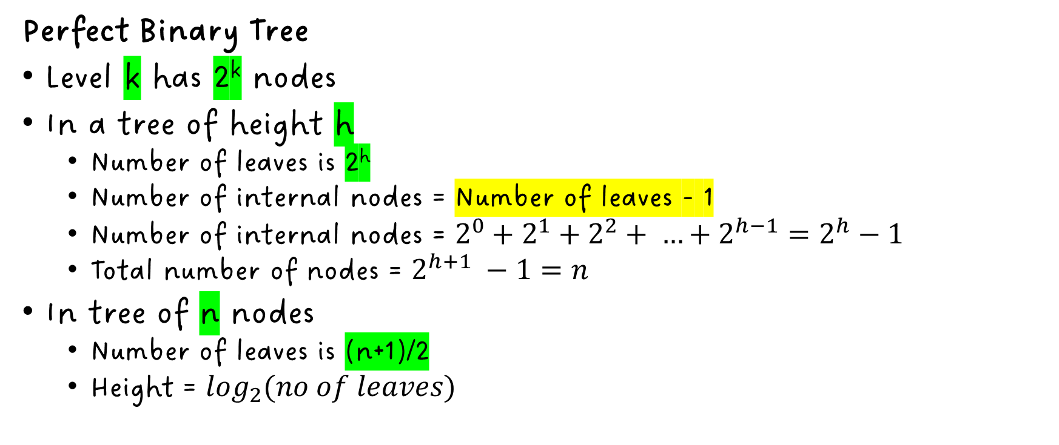
Binary Tree
20
Level 0
2
5
Level 1
Perfect Binary Tree
Level k has 2^{k} nodes
In a tree of height h
Number of leaves is 2^{h}
Number of internal nodes = Number of leaves - 1
Number of internal nodes = $2^{0}+2^{1}+2^{2}+ …+2^{h−1}=2^{h}−1$
Total number of nodes = $2^{h+1} −1=n$
In tree of n nodes
Number of leaves is (n+1)/2
Height = $\log_{2}(no of leaves)$
27
43
28
21
Level 2
4
6
9
10
12
15
34
45
Level 3

Slide 9
Binary Tree
20
2
5
Complete Binary Tree
All levels are full except the last level.
Questions for you
Find the minimum height of a binary tree if number of nodes is given to you.
Find the maximum height of a binary tree if number of nodes is given to you.
27
43
28
21
4
6
9
10

Slide 10
Tree ADTs
Generic container methods:
size(), isEmpty(), elements()
Positional container methods:
position(), swapElements(p, q), replaceElements(p, e)
Query methods:
isRoot(p), isInternal()
Accessor methods:
root(), parent(p), children(p), leftChild(p), rightChild(p), siblings(p)

Slide 11
Binary Tree: Node Structure & Representation
Pointer to Parent
e.data
e.p
Pointer to left child
data
e.left
e.right
Pointer to right child

Slide 12
Tree Traversals
Traversal means visiting all nodes in a tree following some specific order.
Preorder: RootNode → Left → Right
Postorder: Left → Right → RootNode
Inorder: left → RootNode → Right
N
N
N
L
R
L
R
L
R
Preorder
Postorder
Inorder

Slide 13
Tree Traversal
Algorithm: preOrder(v)
if (v = null) then
return
else
visit(v)
preOrder(v.leftChild())
preOrder(v.rightChild())
Algorithm: postOrder(v)
if (v = null) then
return
else
postOrder(v.leftChild())
postOrder(v.rightChild())
visit(v)

Slide 14
Tree Traversal
20 - 2 - 27 - 35 - 45 - 43 - 5 - 28 - 21
2 - 27 - 35 - 45 - 43
Preorder
20
27 - 35 - 45
2
5
5 - 28 - 21
27
43
28
21
35
45

Slide 15
Tree Traversal
Questions for you
Explore how inorder traversal works? Write the recursive algorithm for inorder traversal. Write a the recursive algorit
Postorder
20
2
5
27
43
28
21
35
45
35 – 45 – 27 – 43 – 2 – 28 – 21 – 5 – 20

Slide 16
Some common questions to ask your student.
Preorder and Inorder traversal is given. Can you construct a tree from it?
Preorder: A B D H E C F I G J K
Inorder: D H B E A I F C J G K
Inorder and Postorder traversal is given. Can you construct a tree from it?
PostOrder: H I D J E B K F G C A
Inoredr: H D I B E J A K F CG
Preorder and Postorder traversal is given. Can you construct a tree from it?

Slide 17
Short Quiz
Nodes in a tree that have the same parent are called ____________.
Ancestor
Leaves
Descendants
Siblings
Which of the following is true about the degree of a node in a tree?
It is the number of children of the node.
It is the depth of the node.
It is the number of siblings in the tree.
It is the number of leaves in the tree.

Slide 18
Short Quiz
Possible number of children that a binary tree node can have?
3
1
0
2
Which of the following statements is true about a leaf in a binary tree?
It is the root of the tree.
It has exactly two children.
It is always at the highest level of the tree.
It has no children.

Slide 19
Short Quiz
What is the total number of nodes in a perfect binary tree of height h?
2^{h−1}
2^{h+1}
2^{h+1} − 1
2^{h}
Which of the following is true about binary trees? Select all that apply.
A complete binary tree is a tree that has all its levels filled except possibly the last one.
A complete binary tree is a tree that has all its levels filled.
Binary tree is a tree that has 2 children for every internal node.
Binary tree is a tree that has 1 or 2 children for every internal node.

Slide 20
Short Quiz
Which of the following are the positional container methods for trees? Select all that apply.
isRoot(P)
position()
replaceElement()
swapElement()

Slide 21
Short Quiz
Which of the following are correct about the following binary tree? Select all that apply.
The postorder traversal of the tree is: 2 5 11 6 7 5 9 9 1
The preorder traversal of the tree is: 1 7 2 6 5 11 9 9 5
The inorder traversal of the tree is: 2 7 6 5 11 1 9 5 9
The inorder traversal of the tree is: 1 7 2 6 5 11 9 9 5
1
7
9
2
6
9
5
11
5

Slide 22
Short Quiz
The given numbers 7, 5, 1, 8, 3, 6, 0, 9, 4, and 2 are inserted in that order into an initially empty binary search tree. What is the inorder traversal sequence of the resultant tree?
0 1 2 3 4 5 6 7 8 9
0 2 4 3 1 6 5 9 8 7
9 8 6 4 2 3 0 1 5 7
7 5 1 0 3 2 4 6 8 9

Slide 23
Binary Search Tree
It is a binary tree
All keys (data) in the left subtree of the root are less than or equal to the key (data) in the root.
All keys (data) in the right subtree of the root are greater than the key (data) in the root.
12
7
19
5
9
29
8
11
25

Slide 24
Searching in BST
SerachNode (root, 11)
SearchNode(root, key)
if root = NULL OR root.data = key then
return root
if key <= root.data then
return SearchNode(root.left, key)
else
return SerachNode(root.right, key)
12
11 < 12
7
19
11 > 7
5
9
29
11 > 9
8
11
25
Time Complexity: Running time on tree of height h is O(h)
Questions for you
Suppose you have n nodes in a tree. Is it true that the worst-case running time for searching an element will be O(n)? If yes, how? If no, why?

Slide 25
Min and max element in BST
MinElement(root)
while root.left != NULL do
root = root.left
end while
return root
12
7
19
5
9
29
8
11
25
Time Complexity: O(h)
Questions for you
Can you write an algorithm to find the 2nd smallest element in BST?

Slide 26
Insertion in BST
InsertElement(root, new)
set parent = root
while parent != NULL do
if new.data <= parent.data then
set parent = parent.left
else
set parent = parent.right
end while
if root = NULL then
set root = new
if new.root <= parent.data then
set parent.left = new
else
set parent.right = new
Search the spot and insert
Search the spot
Insert 11
11 <= 12
12
7
19
11 > 7
5
9
29
Insert
11 > 9
8
11
25

Slide 27
Insertion in BST
Time complexity: O(h)
Questions for you
What is the worst case time complexity?

Slide 28
Deletion in BST
Three cases
Delete leaf node
Delete an internal node with one child
Delete an internal node with two children
Case-1: Delete a leaf node
12
12
7
19
7
19
5
9
29
5
29

Slide 29
Deletion in BST
Case-2: Delete an internal node with one child
12
12
7
19
Move up to replace 19
7
29
5
9
29
5
9

Slide 30
Deletion in BST
Case-3: Delete an internal node with two children
Find the target node to delete.
Go to its right child, then follow the left pointer all the way down until you hit the bottom. This is the in-order successor.
Copy the value of the successor into the target node.
Recursively delete the original successor node from the right subtree (it will always fall into Case 1 or Case 2, making it easy to delete).
12
Target
17
17 copied here
7
19
7
19
5
9
17
29
5
9
17
29
In-order successor
18
Delete 17 using case-2
18

Slide 31
Short Quiz
In a binary search tree, the keys stored in the right subtree of a node are always __________.
Less than the key stored at the current node
Greater than the key stored at the current node
Less than or equal to the key stored at the current node
Equal to the key stored at the current node
After the insertion of n keys, the worst-case running time of searching of a binary search tree is ________.
O(log²n)
O(n)
O(logn)
O(n*logn)

Slide 32
Short Quiz
What is the condition that you repeatedly check for, in order to find the minimum element of a binary search tree?
root.right != NULL
Root.right = null
Root.left != null
Root.left = null
The average time complexity of insertion of an element in a Binary search tree is _________________.
O(log²n)
O(n)
O(logn)
O(1)

Slide 33
Short Quiz
If x is the root element and z is the element you wish to insert into the BST rooted at x, which of the following conditions should hold true such that z gets inserted into the left subtree of x?
z >= x.key
z = x.key
z < x.key
z > x.key
What is the correct method of deleting a node from a BST that has two children?
Delete the node along with its children
Delete the node and make one of the children the parent of the other
Deletion is not possible in such a case
Replace the value at the node with its successor and delete the successor.

Slide 34
Short Quiz
What are the different cases that we encounter while deleting a node (say x) from a BST? Select all that apply.
x has one child
x has two children
x has no children
x has three children
Which tree traversal technique is used to sort data in a BST?
Elements cannot be sorted using a BST
Inorder
Preorder
Postorder

Slide 35
AVL (Adelson-Velskii and Landis) Tree
Motivation:
Lets build a bst using the following sequence of elements:
20 2 27 5 21 43 28 45 35
Analogy:
Office Workload
Balance Factor
Height difference between the left and right subtrees is called the Balance Factor (BF).
It is calculated per node
20
2
27
5
21
43
28
45
35
$$Balance Factor= {Heght}_{ls} − {Height}_{rs}$$

Slide 36
AVL Tree
Healthy AVL tree
Balance Factor of Every single node is strictly -1, 0, or 1
C structure
-2
-2
20
-2
-1
-2
2
27
0
1
0
struct Node {
int data;
struct Node* left;
struct Node* right;
int height; /* ◄ NEW: AVL trees need this to calculate Balance Factors instantly! */
};
5
21
43
-1
0
28
45
0
35

Slide 37
AVL tree rotations
-2
-1
20
-1
-2
-1
A
-1
2
27
Four type of rotations
Left-Left: Left child’s left subtree of A
Right-Right: Right child’s right subtree of A
Left-Right: Left child’s right subtree of A
Right-Left: Right child’s left subtree of A
0
0
1
0
0
0
5
21
43
0
-1
0
0
28
45
0
A
35
A
A
A
20
20
20
20
10
30
10
30
5
40
15
25

Slide 38
AVL tree rotations
A
C
w3
Left-Left Rotation
w1
w2
0
1
20
20
-1
2
-1
0
15
A
25
15
23
A
C
0
1
0
1
10
17
23
10
17
22
25
1
0
0
A
0
0
w1
16
22
16
w2
w3
0

Slide 39
AVL tree rotations
A
w3
C
w2
w1
Right-Right Rotation
0
1
20
20
-1
-2
-1
0
15
A
25
15
30
C
0
1
-1
1
0
10
17
30
10
17
25
35
0
0
A
0
A
w1
0
0
16
35
16
w3
w2

Slide 40
AVL tree rotations
A
-2
A
-2
0
25
25
28
Right-Left Rotation
-1
1
R2
A
28
30
25
30
0
0
0
0
R1
30
28
0
0
1
20
20
20
-1
-2
-1
A
-2
-1
0
15
A
25
15
25
15
28
0
1
1
1
-1
1
0
0
0
R2
0
10
17
30
10
17
28
10
17
25
30
0
R1
0
0
0
0
A
16
28
16
30
16

Slide 41
AVL tree rotations
Left-Right Rotation
A
A
20
20
10
15
15
A
15
10
10
20

Slide 42
AVL tree insertion example
Lets create one avl tree from the following entries:
20 17 15 25 45 18 34 10 5 16 19
20
17
17
17
17
15
20
15
20
15
25
15
25
20
45
45
17
17
20
15
25
15
20
17
25
20
45
18
25
15
18
45
18
45

Slide 43
AVL tree insertion example
20 17 15 25 45 18 34 10 5 16 19
20
20
20
17
25
17
25
17
34
15
18
45
15
18
34
15
18
25
45
34
45
20
20
17
34
17
34
15
18
25
45
10
18
25
45
10
5
15
5

Slide 44
AVL tree insertion example
Left for audience
20 17 15 25 45 18 34 10 5 16 19
20
20
20
17
34
17
34
15
34
10
18
25
45
15
18
25
45
10
17
25
45
5
15
10
16
5
16
18
16
5

Slide 45
Deletion in AVL tree
Perform standard BST deletion.
Update the height of the ancestor node.
Get the balance factor of the ancestor node to check if it became unbalanced.
If unbalanced, perform the appropriate rotation.

Slide 46
Deletion in AVL tree
Lets learn it through example.
2
20
20
25
10
30
10
30
10
30
8
15
25
35
8
15
25
8
15
5
13
17
5
13
17
5
13
17

Slide 47
Deletion in AVL tree
Left-left heavy (LL)
You deleted a node from the right subtree of the parent.
This leaves the Left subtree significantly heavier.
Solution:
A single Right Rotation around the Parent node.
2
25
10
10
30
8
25
8
15
5
15
30
5
13
17
13
17

Slide 48
Deletion in AVL tree
Right-Left heavy (RL)
You deleted a node from the Left subtree of the parent. This leaves the Right subtree heavier, but the right child itself is left-heavy (forming a > shape path down from the parent).
Solution:
A double rotation: Right Rotation on the Child, then Left Rotation on the Parent.
-2
10
10
10
15
8
25
8
25
8
15
10
25
5
15
30
15
30
13
25
8
13
17
30
13
17
13
17
17
30

Slide 49
Deletion in AVL tree
Right-Right Heavy (RR)
You deleted a node from the Left subtree of the parent.
This leaves the Right subtree much heavier.
Solution:
A single Left Rotation around the Parent node.
-2
15
15
15
15
25
10
25
10
25
10
25
25
15
30
8
13
17
30
13
17
30
17
30
17
30
17

Slide 50
Deletion in AVL tree
Left-Right Heavy (LR)
You deleted a node from the Right subtree of the parent. This leaves the Left subtree heavier, but the left child itself is right-heavy (forming a < shape path down from the parent).
Solution:
A double rotation: Left Rotation on the Child, then Right Rotation on the Parent.
2
25
25
25
15
15
30
15
15
17
25
17
17
17

Slide 51
Time Complexity of AVL trees
Operations:
Find
Insert
Delete
O(log n)

Slide 52
Short Quiz
AVL tree is a binary search tree in which the height of the child subtrees of a given node can differ by _____________________.
Zero (both have the same height)
At most 1
At least 1
At least 2
If there are n nodes in an AVL tree, the height of the tree is _____________________.
O(n)
O(1)
O(n log n)
O(log n)

Slide 53
Short Quiz
If for every node v in a binary tree T, the height of v’s children differ by at most one, then the tree is said to be ___________.
Unbalanced
Height-balanced
Complete
A BST
To rebalance the subtree at a particular node of an AVL tree, which of the following operations is used?
Rotation
Join
Delete
Insert

Slide 54
Short Quiz
What are the different types of rotations in the context of inserting an element in an AVL tree?
Triple Rotation
Double Rotation
Single Rotation
No rotation
Which of the following in the context of AVL trees insertion involve(s) a double rotation? Select all that apply.
RL
LR
RR
LL

Slide 55
Short Quiz
What are the different types of rotations in the context of inserting an element in an AVL tree?
Triple Rotation
Double Rotation
Single Rotation
No rotation
Which of the following in the context of AVL trees insertion involve(s) a double rotation? Select all that apply.
RL
LR
RR
LL

Slide 56
Red Black Tree
Every node is colored either Red or Black.
The Root node is always Black.
Every leaf node (represented explicitly as NULL) is considered Black.
If a node is Red, both of its children must be Black (No two adjacent Red nodes allowed vertically).
For each node, all simple paths from that node to descendant NULL leaves must contain the same number of Black nodes (This is known as the Black Height).

Slide 57
Red Black Tree
2
20
2
1
15
34
Example:
Is the following are red black tree? If no, why?
1
1
1
10
17
N
45
1
5
N
N
N
N
N
N
N
5
5
5
3
8
4
8
4
7
7
9
3
6
9
6
6
2

Slide 58
Red Black Tree
Some new terms:
Grandparent: 10’s grand parent is 20
Sibling: 34 and 15 are siblings
Uncle: 10’s uncle is 34
Nephews: 10 and 17 are nephews of 34
Near Nephew: 17 is 34’s near nephew
Far Nephew: 10 is 34’s far nephew
20
15
34
10
17
N
45
5
N
N
N
N
N
N
N

Slide 59
Operations on Red Black Tree
Searching:
No discussion needed, because it is a bst. Therefore same searching algorithm works here.
Insertion
Deletion

Slide 60
Operations on Red Black Tree
Insertion
First: Insert the key following bst rule.
Next: We decide the color:
If black?
Black height problem
If red?
1. Root is always black 2. red node should not have red child
Conclusion: New node color is always red.
Now,
By deciding the color to be red, black height problem gone.
If node is inserted in an empty tree (that is, node is root node), we need to color it black.
If new node’s parent is black, no violation.
If new node’s parent is red?

Slide 61
Operations on Red Black Tree
Insertion
If new node’s parent is red?
Parent is left Child
Case L_1: Uncle is red
Recolor
Case L_2: Uncle is black
Case L_2a: Node is right child
Rotate left about parent and transform to case L_2b
Case L_2b: Node is left child
Recolor and Rotate right about the grandparent.
Parent is Right Child
Case R_1: Uncle is red
Recolor
Case R_2: Uncle is black
Case R_2a: Node is left child
Rotate Right about parent and transform to case R_2b
Case R_2b: Node is right child
Recolor and Rotate left about the grandparent.

Slide 62
Operations on Red Black Tree
Deletion:
BST rule will be followed.
If the node to be deleted has two children?
The case is reduced to a node which has only one right child or no child.
Suppose A is a node to be deleted, there are 6 cases:
Case-1: A is red and has no children
Case-2: A is red, and its only child is red
A
No property violated and the tree remains red black after deleting node A.
A
Impossible case, because it means that there was a double red problem in the tree.
N
N
N
C
N
N

Slide 63
Operations on Red Black Tree
Deletion
Case-3: A is red, and its only child is black
Case-4: A is black and has no children
A
A
After deletion the black height property would be violated and we need to restore this property. There are many subcases to be considered
Impossible case, because this means node A was violating property: black height
N
C
N
N
N
N
Case-5: A is black, and its only child is red
A
The node A is deleted and its red child takes its place. This might create a double red problem if A had a red parent. The black height problem will definitely be introduced. Both these problems can be removed just by coloring this child black.
N
C
N
N

Slide 64
Operations on Red Black Tree
Deletion
Case-6: A is black, and its only child is black
A
Impossible case, because this means node A was violating property: black height
N
C
N
N

Slide 65
Graph data structure
a
G = (V,E)
V = {a, b, c, d}
E = {(a, b), (b, c), (c, d), (d, a), (d, b)}
Two types:
Directed
Undirected
b
d
c
Undirected Graph
a
b
d
c
Directed Graph

Slide 66
Graph data structure
Graph Terminologies:
Weighted graph
Subgraph
Adjacent Vertices
Degree of a vertex
Indegree
Outdegree
Path
Simple Path
Cycle
Graph Terminologies:
Connected graph
Unconnected graph
Tree
Forest
Complete Graph
Spanning tree
Please plan to show everything visually (proper diagrams) to your students.

Slide 67
Representation of Graph
Adjacency Matrix: 2d array
 | a | b | c | d
a | 0 | 1 | 0 | 1
b | 1 | 0 | 1 | 1
c | 0 | 1 | 0 | 1
d | 1 | 1 | 1 | 0
a
b
d
c

Slide 68

Representation of Graph
Adjacency List: Linked list
a
b
d
a
b
b
a
d
c
d
c
b
d
c
d
a
b
c

Slide 69
Shortest path algorithms
Dijkstra’s Algorithm
f
9
Source
Destination
e
6
2
14
d
c
11
9
a
10
15
7
b

Slide 70
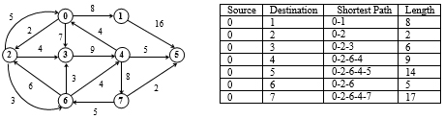
Shortest path algorithms
Dijkstra’s Algorithm

Slide 71
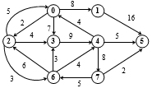
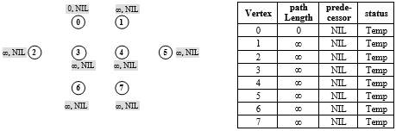
Shortest path algorithms
Dijkstra’s Algorithm

Slide 72
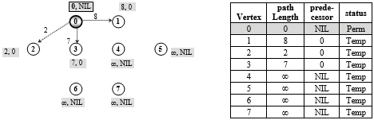
Shortest path algorithms
Dijkstra’s Algorithm
pathLength(0) + weight(0,1) < pathLength(1) 0+8 < ∞
Relabel 1, pathLength[1] = 8, predecessor[1] = 0
pathLength(0) + weight(0,2) < pathLength(2) 0+2 < ∞
Relabel 2, pathLength[2] = 2, predecessor[2] = 0
pathLength(0) + weight (0,3) < pathLength(3) 0+7 < ∞
Relabel 3, pathLength[3] = 7, predecessor[3] = 0

Slide 73
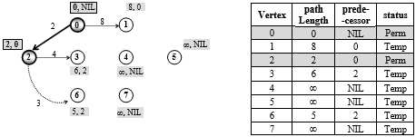
Shortest path algorithms
Dijkstra’s Algorithm
From all the temporary vertices, vertex 2 has the smallest pathlength, so make it permanent. Now, vertex 2 is the current vertex.
Vertices 3, 6 are temporary vertices adjacent to vertex 2.
pathLength(2) + weight(2,3) < pathLength(3) 2+4 < 7
Relabel 3, pathLength[3] = 6, predecessor[3] = 2
pathLength(2) + weight(2,6) < pathLength(6) 2+3< ∞
Relabel 6, pathLength[6] = 5, predecessor[6] = 2

Slide 74
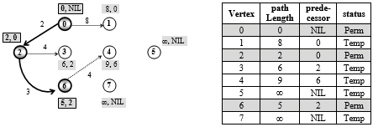
Shortest path algorithms
Dijkstra’s Algorithm
From all the temporary vertices, vertex 6 has the smallest pathlength, so make it permanent. Now, vertex 6 is our current vertex.
Vertices 3, and 4 are temporary vertices adjacent to vertex 6.
pathLength(6) + weight(6,3) > pathLength(3) 5+3 > 6
Do not relabel 3
pathLength(6) + weight(6,4) < pathLength(4) 5+4 < ∞
Relabel 4, pathLength[4] = 9, predecessor[4] = 6

Slide 75
Shortest path algorithms
Dijkstra’s Algorithm
From all the temporary vertices, vertex 6 has the smallest pathlength, so make it permanent. Now, vertex 6 is our current vertex.
Vertices 3, and 4 are temporary vertices adjacent to vertex 6.
pathLength(6) + weight(6,3) > pathLength(3) 5+3 > 6
Do not relabel 3
pathLength(6) + weight(6,4) < pathLength(4) 5+4 < ∞
Relabel 4, pathLength[4] = 9, predecessor[4] = 6

Slide 76
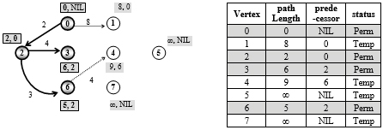
Shortest path algorithms
Dijkstra’s Algorithm
From all temporary vertices, vertex 3 has the smallest pathlength, so make it permanent. Now, vertex 3 is the current vertex.
Vertex 4 is the temporary vertex adjacent to 3.
pathLength(3) + weight(3,4) > pathLength(4) 6+9 > 9
Do not relabel 4

Slide 77
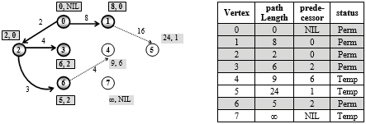
Shortest path algorithms
Dijkstra’s Algorithm
From all temporary vertices, vertex 1 has the smallest pathlength, so make it permanent. Now, vertex 1 is the current vertex.
Vertex 5 is the temporary vertex adjacent to 1.
pathLength(1) + weight(1,5) < pathLength(5) 8+16 < ∞
Relabel 5, pathLength[5] = 24, predecessor[5] = 1

Slide 78
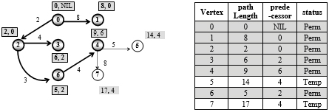
Shortest path algorithms
Dijkstra’s Algorithm
From all temporary vertices, vertex 4 has the smallest pathLength, so make it permanent. Now, vertex 4 is the current vertex.
Vertices 5 and 7 are temporary vertices adjacent to 4.
pathLength(4) + weight(4,5) < pathLength(5) 9+5 < 24
Relabel 5, pathLength[5] = 14, predecessor[5] = 4
pathLength(4) + weight(4,7) < pathLength(7) 9+8 < ∞
Relabel 7, pathLength[7] = 17, predecessor[7] = 4

Slide 79
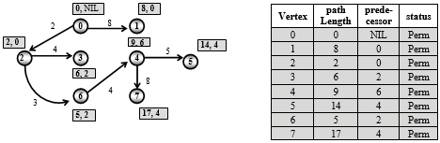
Shortest path algorithms
Dijkstra’s Algorithm
Now, 7 is the only temporary vertex left, and it has a pathLength 17, so make it permanent.

Slide 80
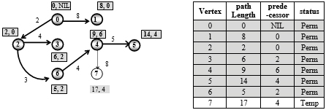
Shortest path algorithms
Dijkstra’s Algorithm
From all temporary vertices, vertex 5 has the smallest pathlength, so make it permanent. Now, vertex 5 is the current vertex.
There is no vertex adjacent to 5.

Slide 81
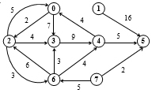
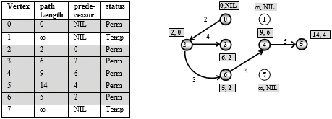
Shortest path algorithms
Please try this one.

Slide 82
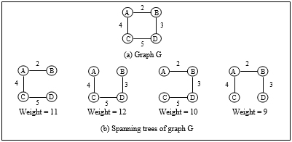
Minimum Spanning Tree
The sum of weights of edges of different spanning trees of a graph may be different.
A spanning tree of graph G whose sum of weights is minimum amongst all spanning trees of G, is called the Minimum Spanning Tree of G.

Slide 83
Minimum Spanning Tree
Prim’s Algorithm
8
7
b
e
f
9
4
2
4
a
6
d
14
h
8
7
6
10
c
g
10
b
e
f
a
d
h
c
g

Slide 84
Minimum Spanning Tree
Kruskal’s algorithm
8
7
b
e
f
9
4
2
4
a
6
d
14
h
8
7
6
10
c
g
b
e
f
10
a
d
h
c
g

Slide 85
Short Quiz

Slide 86
Some useful Site
https://visualgo.net/en
https://github.com/sisirjena/DataStructureUsingC

